Slide 1

Metropolitan College
Project:
Type II Diabetes Management Web-Based Application
A Teaching tool for the BU Health Informatics Course
Iteration #3 – 12/5/2013
CS673 Software Engineering
Fall 2013

Slide 2
Team members:
Team member | Role
Jeff Andre | Project leader, Requirements
Bogdan Chayka | Backup project leader, Design leader
Jason Lu | Configuration leader
Maura Huff | Implementation leader
Wenjie Shi(Jenny) | Environment and integration leader
Yike Xue (Eva) | QA leader
Yingyuan (Allen) Zhang | Requirements leader
Yulu Liu | Design leader
Yehuan Huang (Tommy) | Developer

Slide 3
Project Overview
This project developed for the MET Health Informatics Lab (MET-HILAB) under direction of Professors Guanglan Zhang and Vladimir Brusic (the customers).
GOAL: to develop a type 2 diabetes management web based application.
PURPOSE: this application is intended to be used as a teaching tool that will demonstrate implementation of a real clinical algorithm, examples of successful treatment decisions, situations where clinical algorithms may fail, and to provide a platform for familiarization of students with the process of development and implementation and use of medical algorithms.

Slide 4
Description
Our application has limited functionality, comparing with existing Electronic Health Records (EHR), only enough to support demonstration of working Clinical Decision Support System (CDSS) based on real world Medical Algorithm.
Application include five major parts:
a) user interface
b) database
c) type II diabetes management algorithm
d) health calculators
- Body Mass Index
- A1C-to-Average Blood Glucose Level
e) security

Slide 5
Requirements
User
Patient
Medicine
Visit
Calculator
Secure User Login
Patient Information -Demographics -Medical Problems -Weight, height, waist -A1c measured &Target -BMI &Target
Patient
-Demographics
-Medical Problems
Therapy
Time series data
- A1C
- BMI
UI
A1c, weight, height
&
Medical Problems
Patient
Database
Medical
Algorithms
Recommended Therapy
Notes:
This project will be developed for the MET Health Informatics Lab (MET-HILAB) under direction of Professors Guanglan Zhang and Vladimir Brusic (the customer).The main goal of the project is to develop a type 2 diabetes management web based application which will include four major parts a) user interface, b) a database, c) a type II diabetes management algorithm, and d) health calculators. The purpose of this application is intended to be used as a teaching tool that will demonstrate implementation of a real clinical algorithm, examples of successful treatment decisions, situations where clinical algorithms may fail, and to provide a platform for familiarization of students with the process of development and implementation and use of medical algorithms.

Slide 6
Requirements
User
- Sign Up
- Login
- Logout
Admin
- User management: Edit/Active/Delete User
- Medicines Management
- List All Patients

Slide 7
Requirements
Patient
- Add Patient
- Search Patient
- List Patient
- Update Patient
- Delete Patient

Slide 8
Requirements
Medicine
- Add medicines
- List medicines
- View medicines
- Update medicines
- Delete medicines

Slide 9
Requirements
Visit
- Add visits
Medical History and Complaints
Drug Allergies and Contraindications
Vitals and Labs
Therapy Goals
- Medical algorithm
Run medical algorithm
Save / Edit algorithm results
- View visits
Visit history
BMI chart
A1C chart

Slide 10
Requirements
Calculator
- BMI(Body Mass Index) Calculator
- A1C Calculator
Race
Height
Weight
BMI
Weight Classification
Obesity Class
Gender
Waist Circumference
Disease Risk
A1C
eAG
Message of A1C level

Slide 11
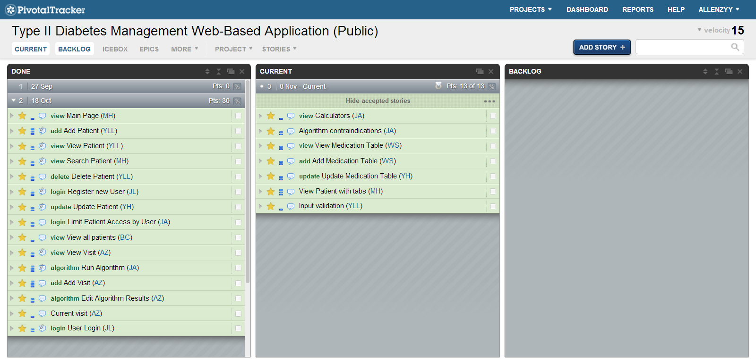
Requirements
User Story (Pivotal Tracker)

Slide 12
User Stories for Iteration #3
Input Validation
View patient with tabs
Add / Update / View medication table
Algorithm checks contraindications
Calculators
We have done all of these requirements
in this iteration.

Slide 13
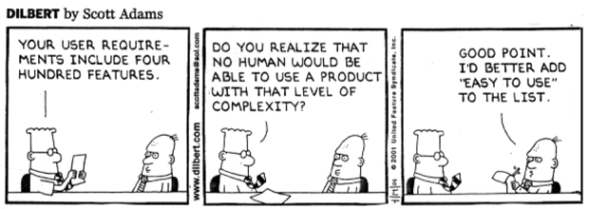

Slide 14
MVC Architecture
View
Controller
Model
Users
edit, index
password
profile
signup
usersController
Login(), Logout()
Add(), edit(), delete(), show(), sign_up(), password()
Activate(), deactivate()
users
patients
- diagnoses
- drug_allergies
- visits
- medhistory_complaints
- vitals_labs
- treatments
- treatment_medicines
medicines
Patients
search
add
edit
show
patientsController
search()
add()
edit()
show()
delete()
Visits
index
add
show
gcalgorithm
edit
visitsController
index()
add()
show()
gcalgorithm()
edit
Medicines
add
edit
View all
view
medicinesController
add()
view()
list

Slide 15
The Architecture
MVC
Well-structured DB schema
Multiple validation of user input
Type safe parameters
Notes:
Type safe: php is not strong typing language, actually most of scripting languages are not, which makes security holes.

Slide 16
Why MVC?
More clear for labor division
Solution for html template
Lower the pains and costs of maintenance
Scalability
Notes:
Scalability, maintenance are the keys of modern website projects.
Environments are changing.
Requests are changing.

Slide 17
Template
Template engine
View is the most important for most of the web site.
Art designers hate code
Developers know nothing about art
MVC come to rescue
Notes:
Web site baed on HTML and HTML is an structure language, developers had been suffer for separate presentation layer and logic layer for years.
There are many “Template” language like “Smarty” to be invented to solve this problem, non of them yield very good result, Asking art designer to learn template language is not helpful, the logic and view still mixed together.
MVC for web development become a very important role nowadays.
Controller and Model saved developer
View and Controller saved art designer

Slide 18
Security
Every website is in danger
Firewall is not able to protect you from bad code
Framework itself deals lots of work for us
Password: ‘ OR 1;—
SELECT * from users WHERE username = ‘$username’ AND password = ‘$password’;
SELECT * from users WHERE username = ‘$username’ AND password = ‘’ OR 1;—’;
Notes:
Code injection, XSS, weak password

Slide 19
The implementation
Sub group by M, V, C
One coordinator to oversee the project and provided the solution
Form helper
Notes:
Form help plays a crucial part, it makes sure data from view match the required structure in model.
Saves code in controller.
More dynamic in view.
By providing custom form helper, we successfully reduced the effort on dealing with form, both design and logic parts got clearer.

Slide 20
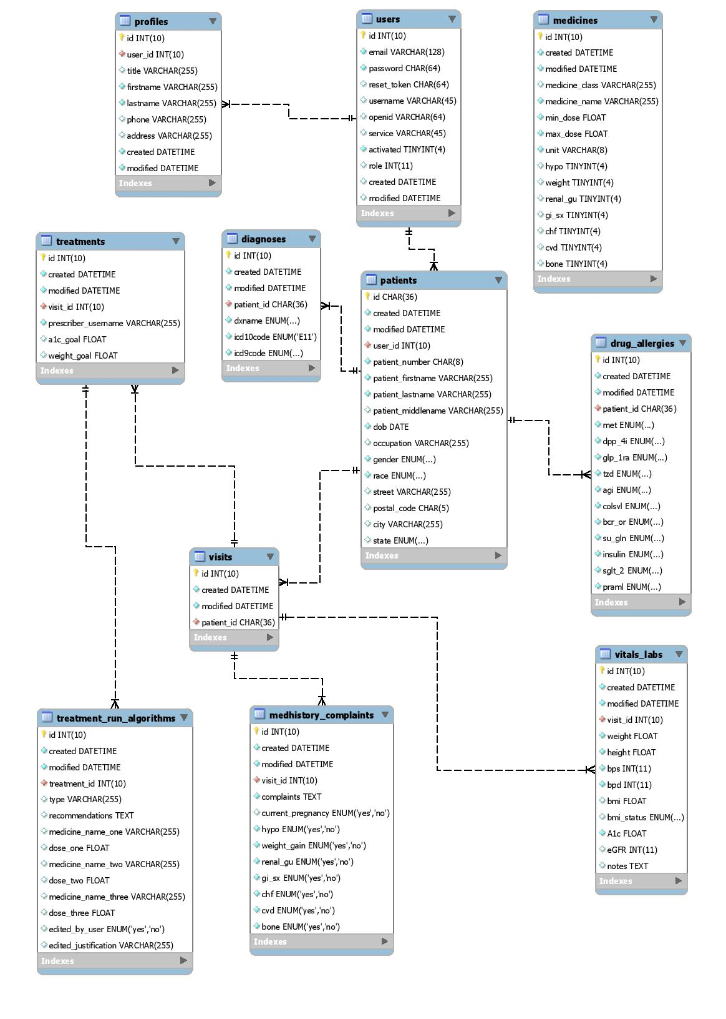
Software Design Database Schema

Slide 21
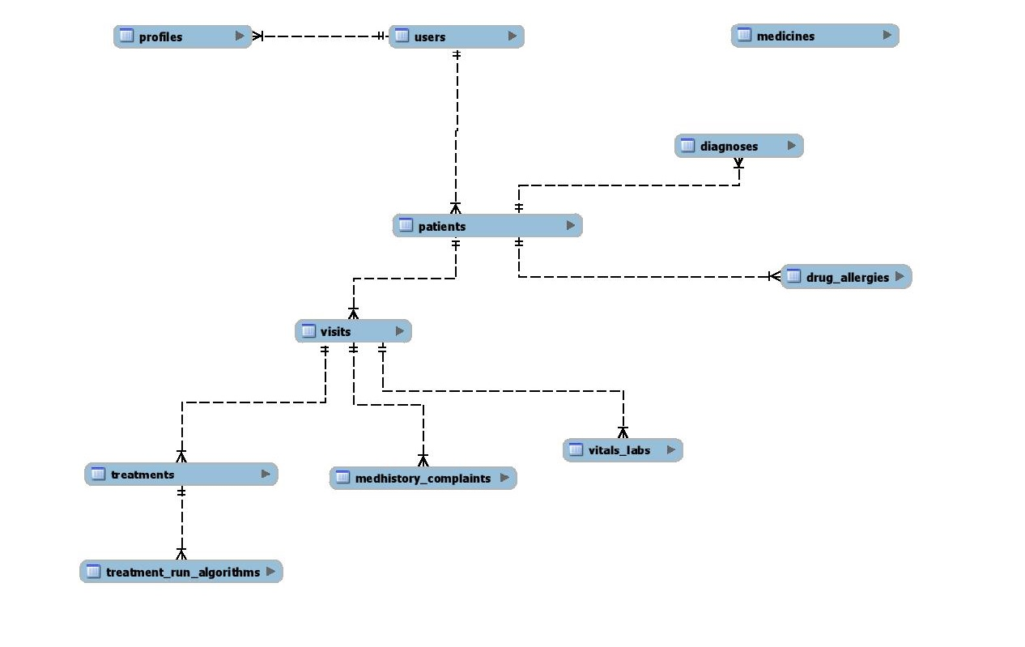
Database Schema
Notes:
Possibility to extend functionality of application. Quick overview of tables and relations.

Slide 22
Algorithm Scope
Based on:
AMERICAN ASSOCIATION OF CLINICAL ENDOCRINOLOGISTS’ COMPREHENSIVE DIABETES MANAGEMENT ALGORITHM 2013 CONSENSUS STATEMENT [1]
Focuses only on Glycemic Control Algorithm for Type II Diabetes Mellitus
Does not include pregnant diabetic patients
[1] AACE Comprehensive Diabetes Management, Endocr Pract. 2013;19(Suppl 2) https://www.aace.com/files/consensus-statement.pdf

Slide 23
Algorithm Limitations
Only focuses on achieving glycemic goals with oral anti-hyperglycemic drugs
Does not include medication dose adjustment
Algorithm only issues alerts for contraindications and drug side effects
Algorithm recommends classes of drugs in some cases (not exact brand/name)
Clinician must make final decision to accept or edit results

Slide 24
Glycemic Control Algorithm Read Patient and Medicine Data

Slide 25
Select Therapy

Slide 26
Select Medications

Slide 27
Check for Risk of Side Effects & Accept or Edit Results

Slide 28
Test
Unit Test: test every page and function.
Module Test:
Test the User Module—sign up, log in, user management, profile management…
Test the Patient Module, Visit Module, etc.—add, update, search, delete
Test the Algorithm
Integration Test:
A complete process using this system
Notes:
As planned in the SPMP, our group has a logical and comprehensive test process. Unit Test->Module Test->Integration Test. We have hundreds of unit tests to test every page and every function. For every module, we have at least 2 people involved in the module test, one of whom is the developer of that module and the others are assigned testers. At the end of every iteration, we had the integration test to test the steady use of the combination of all the modules. The test results, especially those failure test results, would be reported on the GitHub with all the group members and discussed in the meeting. We will assign the important levels of them and assign someone to fix them. By figuring out what should be improved from those test results, our application grew better and better.

Slide 29
Test - Approach
Manually
At the beginning of the project, most test cases were manually tested by developers ourselves.
Selenium/PHPUnit
Gradually, we learned to use some testing tools to do the auto tests, including Selenium and PHPUnit.
Notes:
Just test the website without tools. It is not very efficient, but sometimes it is easier and clearer to exposure the defects of our application.
This is one of the most important things I learned from the test process of our project. Using some test tools to do the automatic tests save us a lot of time and provide us a better way to record the test cases.

Slide 30
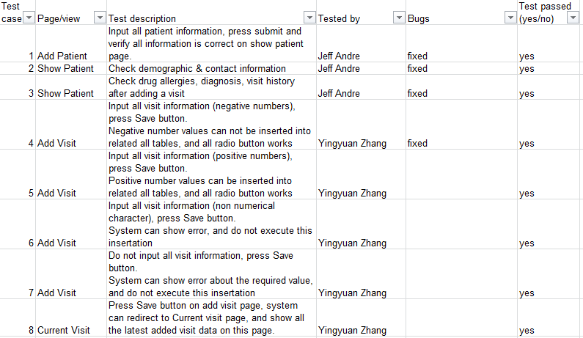
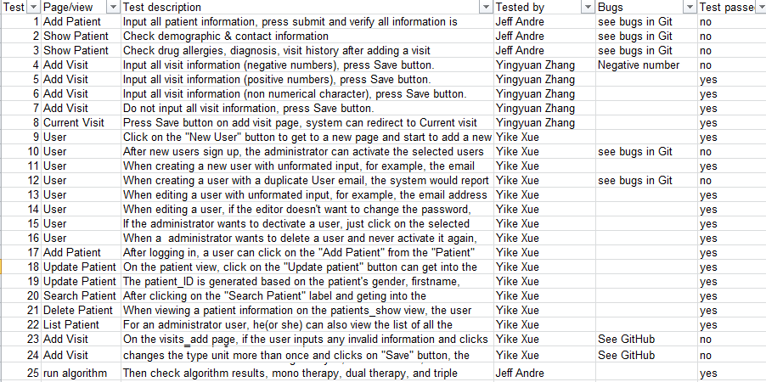
Test - Test Driven Design
TDD used for the algorithm(PHPUnit) and some of other development process.
Notes:
After the first iteration, we gradually applied some TDD concept to our development process. For example, members would test some special cases according to the customer’s requirement(user stories) and make them fail, then we try to fix these bugs and make the test cases passed. According to the test results, we can find out where we should improve and modify. clearly After the tests, we would modify our code until the tests pass. That is how our software getting improved.
The workflow is as following:
1. Create a test case based on the requirements and make it failed.
2. Write code to pass the test in Step1.
3. Refactor so that the code is made to be readable, maintainable and make sure it can still pass the test.
4. Repeat for each new test until all the requirements are met.

Slide 31
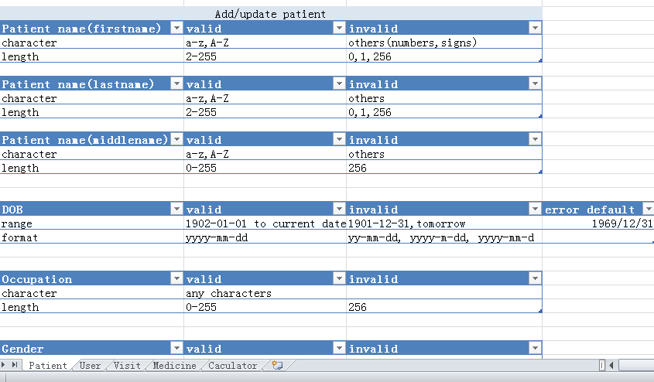
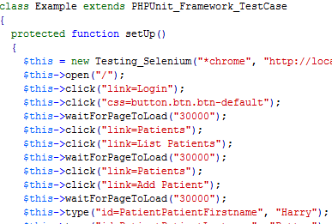
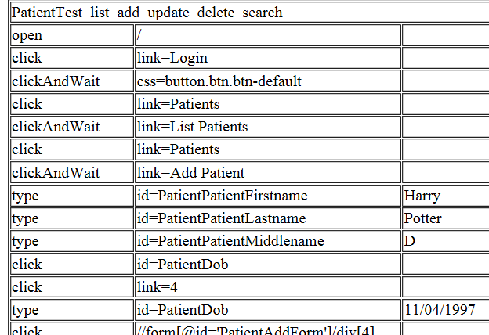
Test – Document
Test Plan/Test Cases
Test Bounder Domain
Readme(for test)--Auto test tutorial
Test Files( .php, .html)
Notes:
We have this listed documents which helped us do the tests and record the test result.
Though we have a lot of test cases, we only recorded some of the most typical ones in our Test Cases Excel file.
Some of the test cases were tested by Selenium or PHPUnit, the HTML file of them show a clear view of the steps we did in tests and values we input in tests.
Besides, by using Selenium IDE plugin, we can reuse some of the test codes to do amount of similar tests conveniently.

Slide 32
Testing - Statistics
The application tests(besides Algorithm):
User Story | Iteration 1 | Iteration 2 | Iteration 3 | Final Tests
Failed test number | 1 | 9 | 2 | 4
Total test number | 9 | 22 | 12 | 43
Test cases pass-rate | 89% | 60% | 83% | 91%

Slide 33
Testing - Algorithm
Tested with PHPUnit & Xdebug
All lines of code coverage: 253/289 = 88%
Major methods: lines of code coverage
gcalgorithm(): 68/70 = 97%
selectMedicines(): 47/49 = 96%
genEffects(): 9/9 = 100%
genAlert(): 22/22 = 100%
patientEffects(): 43/43 = 100%
Access methods tested during integration

Slide 34
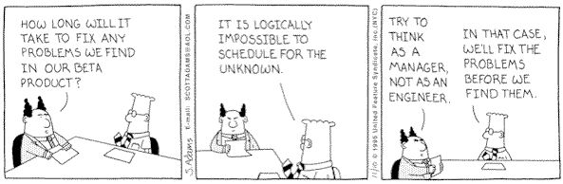

Slide 35
Project Management
Used Agile process to meet customer needs
Had weekly meetings with the customer
Reviewed previous week changes
Prioritized new requirements into required and nice to have features
Reviewed new requirements with team
Implemented new requirements

Slide 36
Project Management
Review Process
Before handing in coding unit – Programmers
Before any integration with others – Involvers
Before every iteration – Every member
Before handing the final product – Every member
Team leader inspects the overall process.
Leaders of each part are responsible for inspecting the specific part and related documents.
All the inspection result should be shown via Github and Pivotal Tracker.

Slide 37
Metrics
Metric | Total
Code lines | 5797
Defect density | 0.5 /KLOC
Achieved requirement proportion | 22/22
Programmer Productivity | 23 lines/hour
Test cases passed rate | 91%
User stories | 22

Slide 38
Product Metrics
Size
 | total
Model | 668
View | 2898
Controller | 1479
Database | 265
Algorithms | 306
Other | 181
The total lines of codes: 5797.
Using SourceCounter tool.

Slide 39
Product Metrics
Performance
Problems | Iteration 1 | Iteration 2 | Iteration 3
Report by customer | 12 | 11 | 6
Report by team | 6 | 39 | 9
Reliability
 | Iteration 1 | Iteration 2 | Iteration 3 | Final Test
Failed test number | 1 | 9 | 2 | 4
Total test number | 9 | 22 | 12 | 43
Test cases pass-rate | 89% | 60% | 83% | 91%

Slide 40
Process Metrics
Defect Density
Problems | Iteration 1 | Iteration 2 | Iteration 3
Defects | 5 | 31 | 3
Code lines | 2596 | 3733 | 5797
Defect density | 2.0 | 8.3 | 0.5
Defect Fixing Time
The average of defect fixing time is 3 days.

Slide 41
Process Metrics
Requirement Stability
The number of initial requirements is 19.
The total number of requirements is 22.
Efficiency
 | Iteration 1 | Iteration 2 | Iteration 3
Code lines | 2596 | 3733 | 5797
Programming time | 51 | 152.5 | 48.5
Productivity(lines/h) | 51 | 18 | 23

Slide 42
Progress & Lessons Learned
Communication…keep it simple
Spend Adequate Time on Design
Realistic Sprint Goals
Allocate Enough Time for Testing
Small Development Teams
Database Management
Notes:
Communication: Our team was very large with 9 members, we realized very quickly that we needed to keep our communication very simple and easy to follow. All of our team had completely different schedules, some working during the day M-F and some free during the day but taking night classes every night M-F. When too many lines of communication were open it was difficult for group members, when they had time to focus on the project, to catch up on all of the communication that took place during the previous 12 or so hours. We had our code repository on GitHub, which sends email updates when changes are made, we also had our bug tracking with Pivotal Tracker which also sent email updates, we had our regular email communication to ask and answer various project topics, and we had our shared google drive to hold all of our project documents. The simpler we kept our communication the easier it was to stay up to speed.
Design: Necessary to spend a large amount of time on Planning, to clearly define requirements and user stories to ensure the system meets the customers needs. When things are rushed in the design phase, not every component is defined and mocked up with enough detail and different team members end up taking their own approach on the components, this leads to mismatched team expectations as well as conflict resolution to get the specific component back on track
Goals: It is necessary to be realistic when setting goals for each sprint, it was easy to over estimate what we were able to do, this leads to us spending all of our time developing to finish every goal that was set for the sprint…which leads to our next issue: testing!
Testing: When development runs over, the amount of time for testing gets cut shorter and shorter, we learned after the first iteration that we needed to make sure that we allocated more time for testing, that way the testing of the previous sprints completed tasks would not run over into the next sprint.
Small Teams: We found that a group of 9 was very difficult to manage, it was much easier when we broke down into smaller teams of 2 or 3 for the front end, database, and integration layer. These small teams also helped to keep our communication simple and concise, as you would only be exposed to the necessary communication traffic.
Database Updates: Over the course of the 3 iterations we have made various changes to our DB, a new sql script was created for every change to the db, it was critical that you run the scripts in the correct order to ensure that your local database was set up correctly, we ended up with many files in this database directory that it became difficult to maintain your local database if you were not intimately familiar with the db changes. We found that we need to have one single file to make all necessary db changes as opposed to many files that needed to be run in a correct order.

Slide 43
Future Work
Automate dosing adjustment
Automate medication selection based on contraindications (not just alerts)
Integrate with real pharmaceutical database
Implement rest of algorithms in the AACE consensus statement 2013
Add medications to A1c graphs to visualize effectiveness of medications
Notes:
Add full automation for dosing adjustment in the algorithm.
Automate medication selection based on drug contraindications instead of just generating alert messages.
There are several aglorithms in the AACE concensus statement so implement more algorithms.
A1C graphs should include medications for each visit so the user can visualize the effectiveness of medicines.

Slide 44
Thank you!

